Slide 1
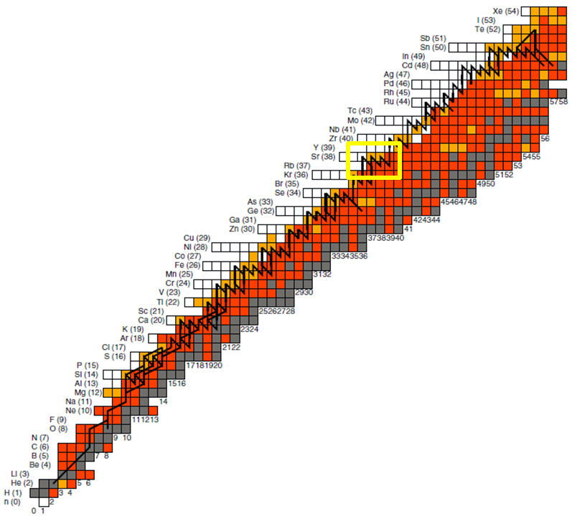
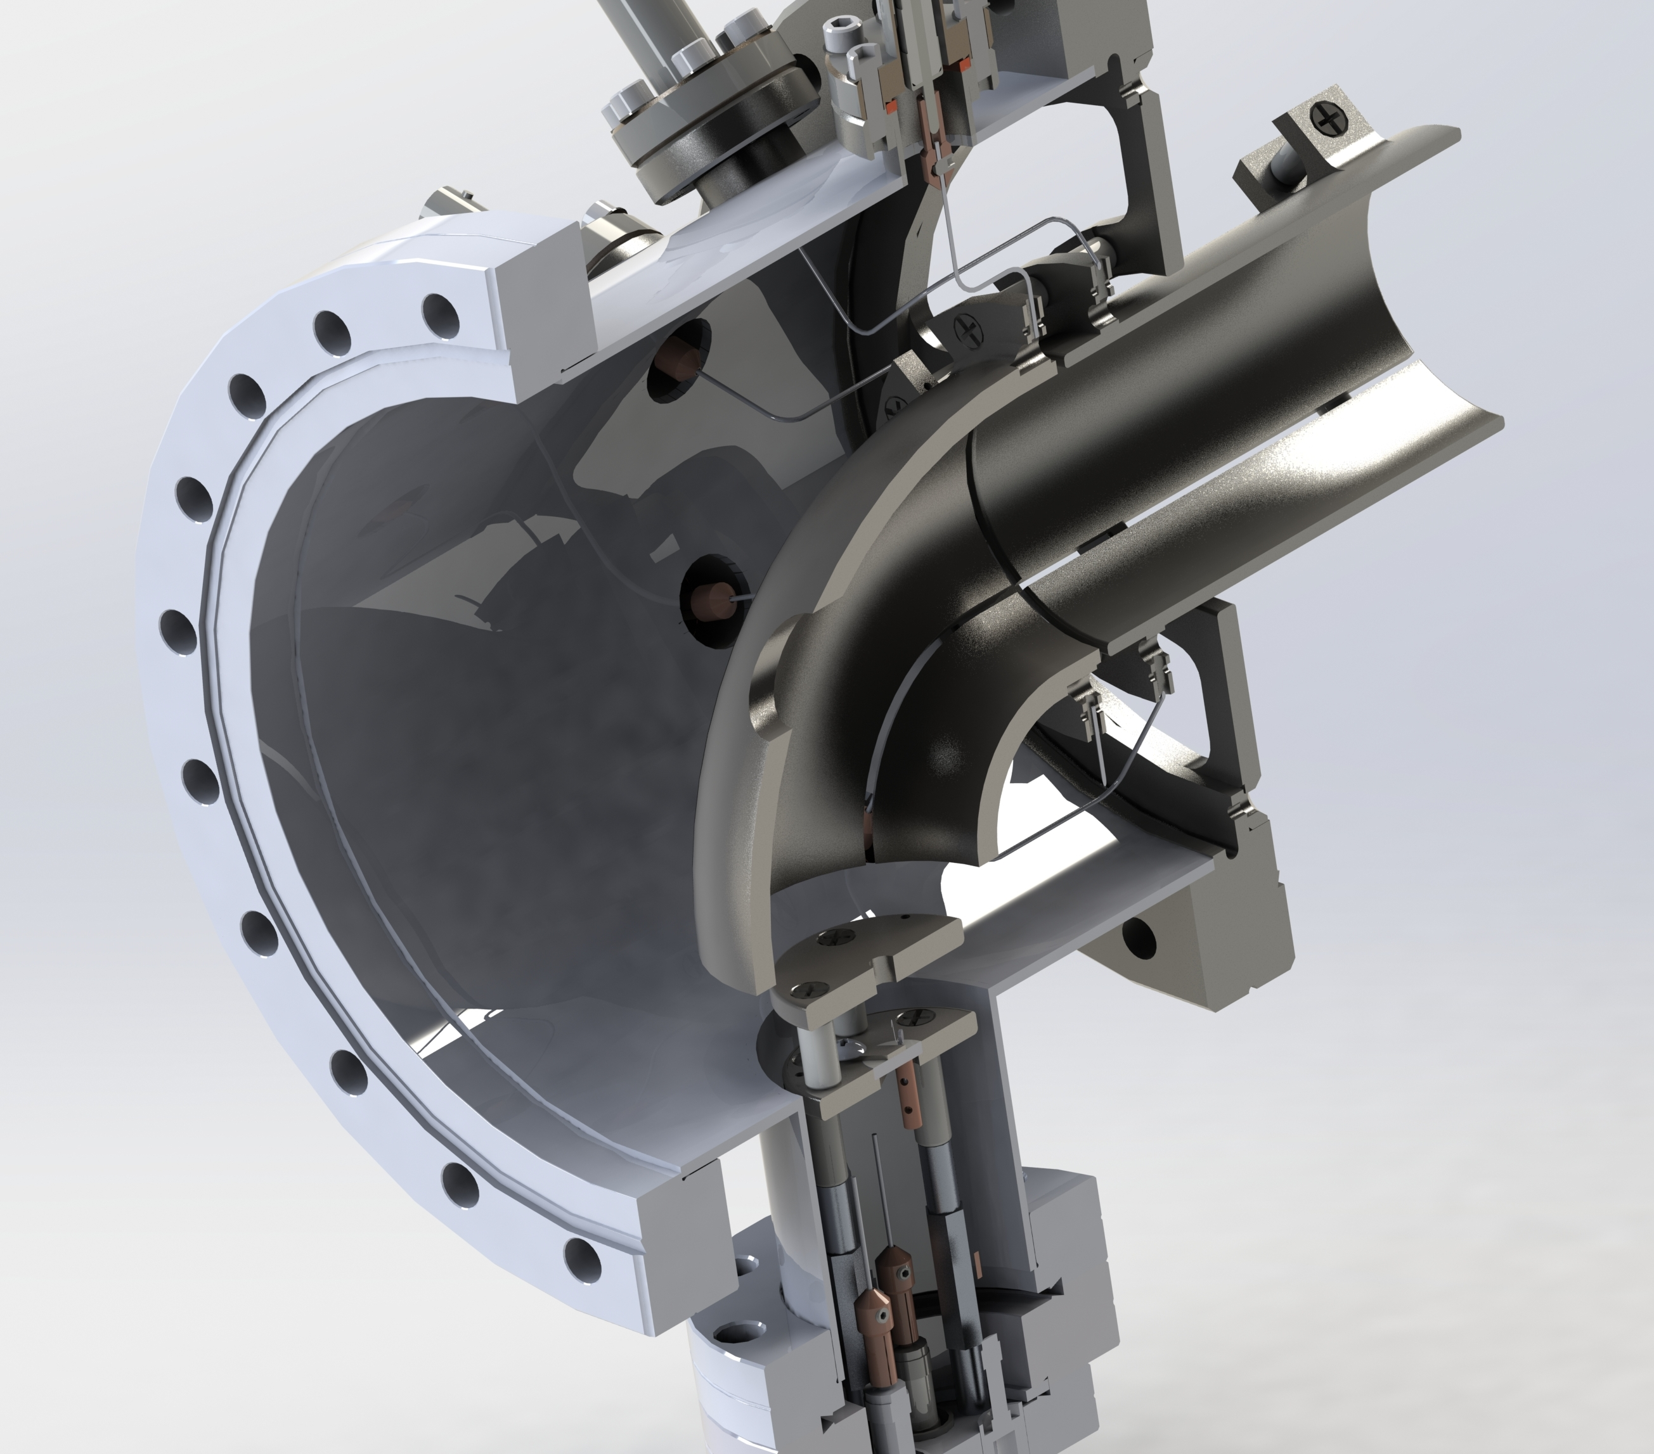
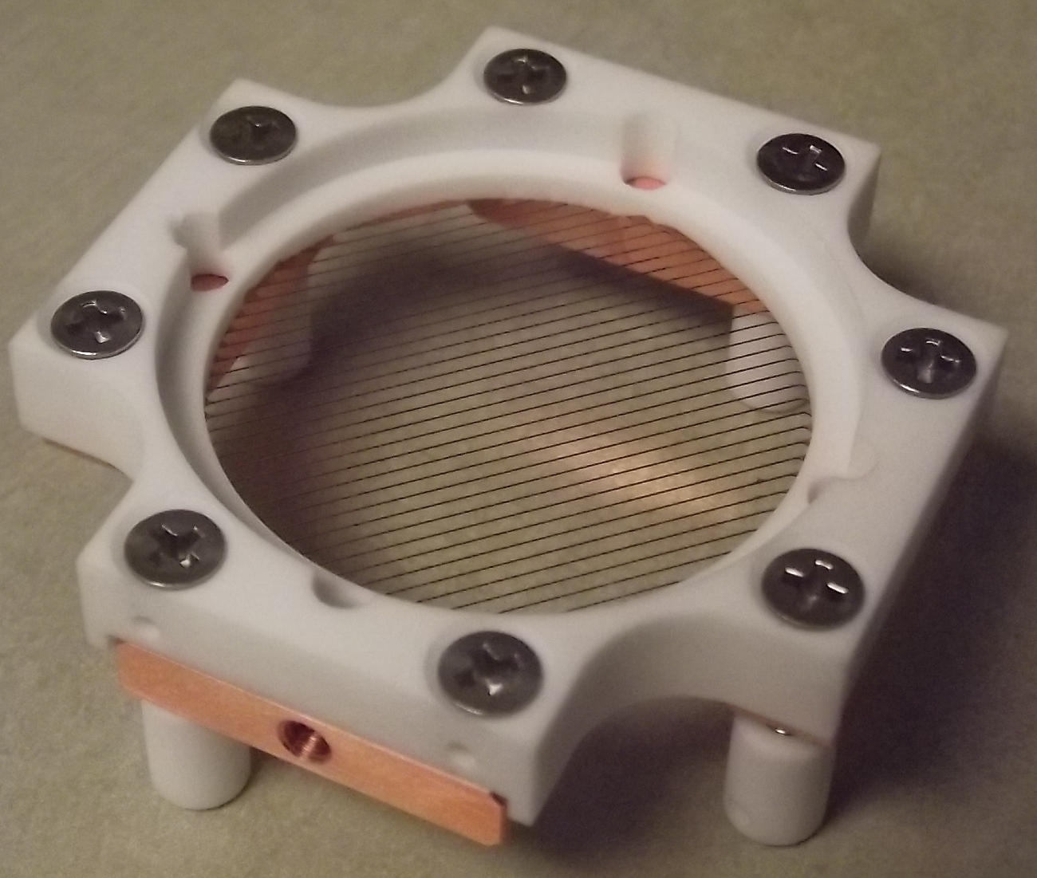
EMMATrap
An important addition to the TRIUMF 5-year plan
July 10, 2017 - TRIUMF
D. Lascar | Postdoctoral Fellow | TRIUMF
T. Brunner | Professor | McGill & TRIUMF

Slide 2
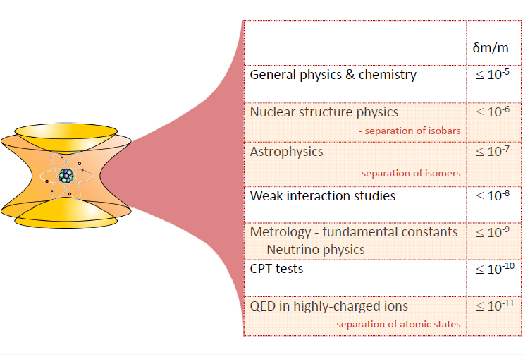
What do masses tell us?
Nuclear Masses of Rare Isotopes:
Magic numbers of exotic nuclei (new shell closures)
R-process waiting points
Inform theory
CKM matrix
Slide courtesy of B. Kootte
Notes:
At this point I’m assuming that everyone in this room has bought into the idea of the importance of mass measurements and their ubiquity in physics.

Slide 3
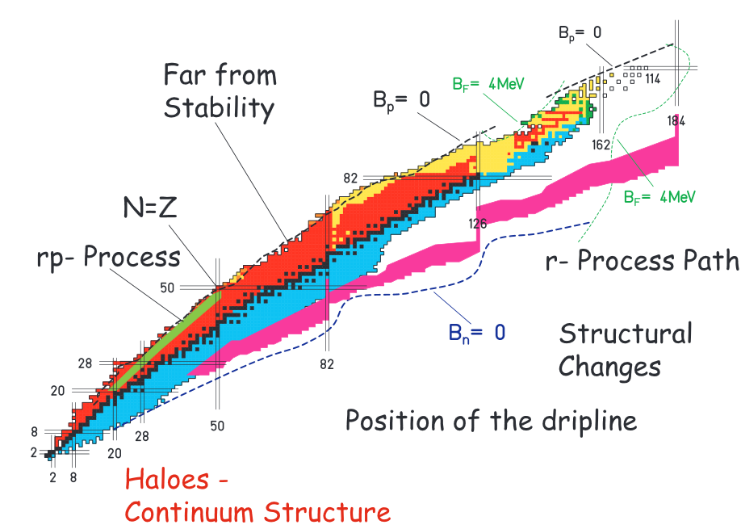
Nuclear structure – ¹⁰⁰Sn
Two production mechanisms:
⁵⁰Cr + ⁵⁸Ni
Chartier et al, PRL 77 12 (1996)
^{124/3}Xe Fragmentation
Hinke et al, Nature 486 7403 (2012)
N=Z
rp-process
r-process path
Structural Changes
Position of the dripline
Haloes –
Continuum Structure

Slide 4
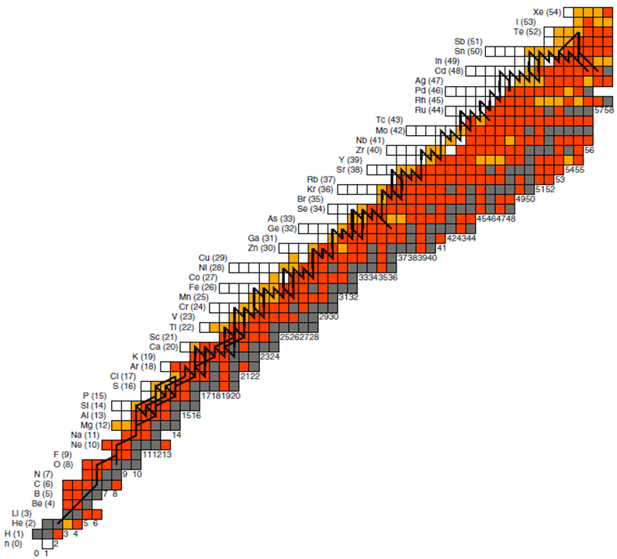
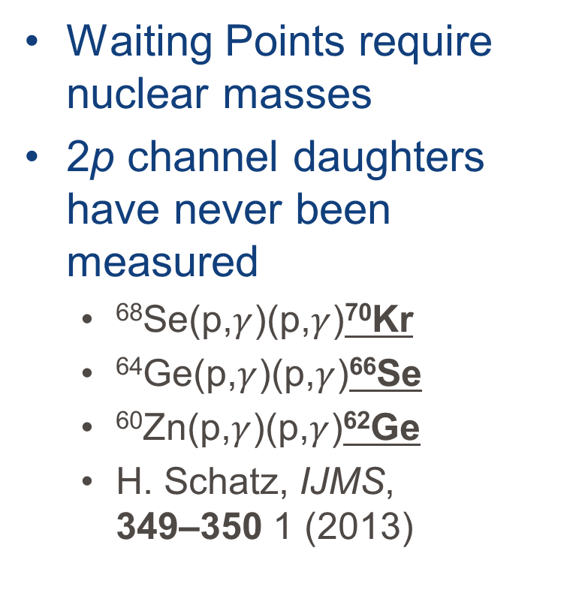
The rp-process
Waiting Points require nuclear masses
2p channel daughters have never been measured
⁶⁸Se(p,$γ$)(p,$γ$)⁷⁰Kr
⁶⁴Ge(p,$γ$)(p,$γ$)⁶⁶Se
⁶⁰Zn(p,$γ$)(p,$γ$)⁶²Ge
H. Schatz, IJMS, 349–350 1 (2013)
ISAC yields
⁷²Kr: 440/s (measured)
⁷⁰Kr: ~0.2/s extrapolated assuming yield reduction of 50/n
→ Impossible to produce at ISAC
→ Possible production at EMMA

Slide 5
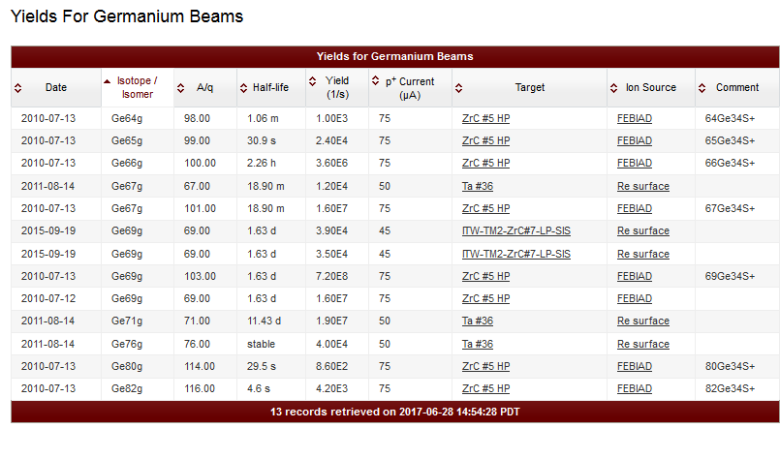
The rp-process
Waiting Points require nuclear masses
2p channel daughters have never been measured
⁶⁸Se(p,$γ$)(p,$γ$)⁷⁰Kr
⁶⁴Ge(p,$γ$)(p,$γ$)⁶⁶Se
⁶⁰Zn(p,$γ$)(p,$γ$)⁶²Ge
H. Schatz, IJMS, 349–350 1 (2013)
~ 1 ion/s extrapolated
TITAN should do ⁶²Ge

Slide 6
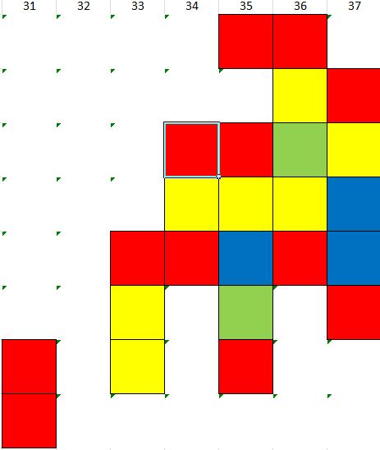
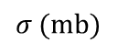
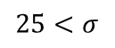
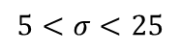
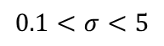
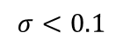
The rp-process case ⁷⁰Kr
³⁵Ar + ⁴⁰Ca
100 MeV
$$σ\text{ (}\text{mb}\text{)}$$
$$25<σ$$
Sr
Rb
Kr
Br
Se
As
Ge
Ga
$$5<σ<25$$
$$0.1<σ<5$$
⁷⁰Kr
$$σ<0.1$$
→ Impossible to produce at ISAC
ISAC yields
⁷²Kr: 440/s (measured)
⁷⁰Kr: ~0.2/s extrapolated assuming yield reduction of 50/n
Z
Possible production and separation at EMMA
N
Notes:
³⁵Ar Production = $6.5×{10}^{6}$/s with Ti target @ 70uA of proton current
70Kr cross section = 0.0457 mb

Slide 7
Slide from Pascal on n-deficient Yb
A slide from Pascal’s proposal on n-deficient Yb will set up our ability to further probe the proton drip line around N=82

Slide 8
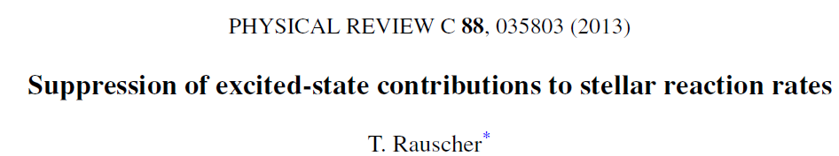
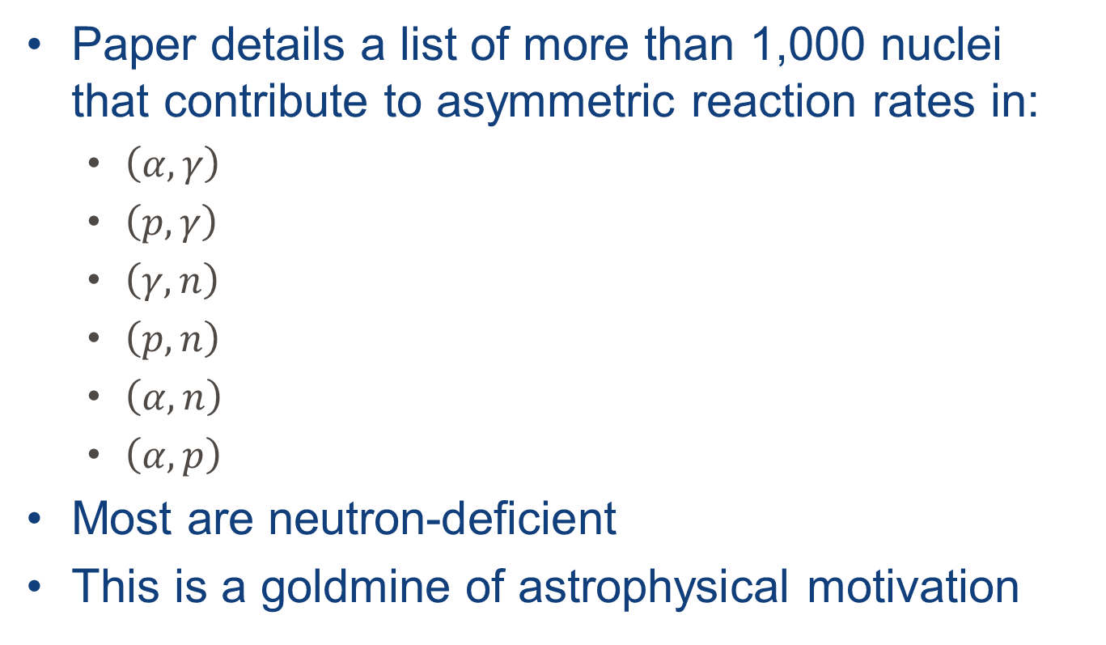
Stellar reaction rates
Paper details a list of more than 1,000 nuclei that contribute to asymmetric reaction rates in:
$\left(α,γ\right)$
$\left(p,γ\right)$
$\left(γ,n\right)$
$\left(p,n\right)$
$\left(α,n\right)$
$\left(α,p\right)$
Most are neutron-deficient
This is a goldmine of astrophysical motivation

Slide 9
Off the coast of the island of stability
Physics Motivation
r-process
Fission cycling
Nuclear structure
Far from Stability
N=Z
rp-process
r-process path
Structural Changes
Neutron-rich:
Md, Pu, Am, Bk
Position of the dripline
Haloes –
Continuum Structure

Slide 10
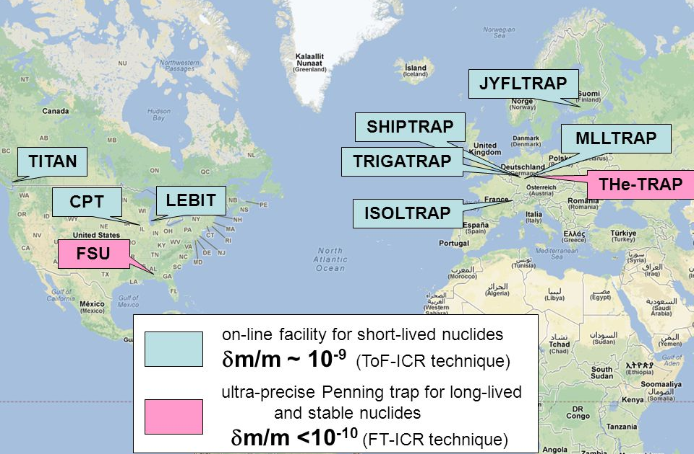
The community has moved to neutron-rich
Image courtesy of S. Eliseev
Notes:
CPT is at CARIBU the moving to a new N=126 factory. LEBIT is part of FRIB. TITAN and ISOLTRAP have similar restrictions and HIE-ISOLDE will push in the neutron-rich direction. MLLTrap is going for long lived. SHIPTRAP out of the FRS is a potential competitor but is focusing on preparing for FAIR.

Slide 11
Advantages of EMMATrap
Contamination reduction of ~10⁵
Access to exotic nuclei
Not limited by ISAC target chemistry
N=Z
rp-process
r-process path
Structural Changes
Position of the dripline
Haloes –
Continuum Structure

Slide 12
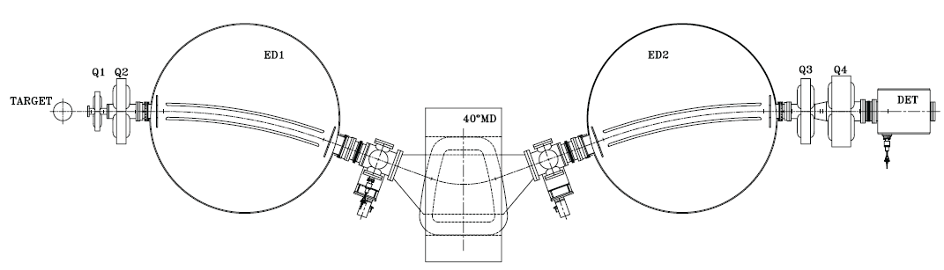
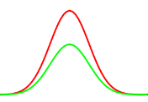
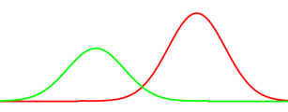
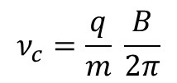
EMMATrap
Particle tagging
Primary
beam
Stopper
gas cell
Laser
ionization
Tagging of reaction products
Stopping of ions in He gas cell
Possibility of laser-ionization (optional)
Cooling and bunching of ions
Separation from contamination in TOF spectrometer
High-precision m/q measurement in Penning trap
Quadrupole stopper and buncher (LPT)
Multi-reflection TOF
m/q separation
Mass measurement
Penning trap
$$ν_{c}=\frac{q}{m} \frac{B}{2π}$$

Slide 13
EMMATrap (5-year plan)
Particle tagging
Primary
beam
Stopping and bunching gas cell
Laser
ionization
Tagging of reaction products
Stopping of ions and bunching in He gas cell
Possibility of laser-ionization (optional)
Separation from contamination in TOF spectrometer
No Penning trap at this stage
Multi-reflection TOF
m/q separation

Slide 14
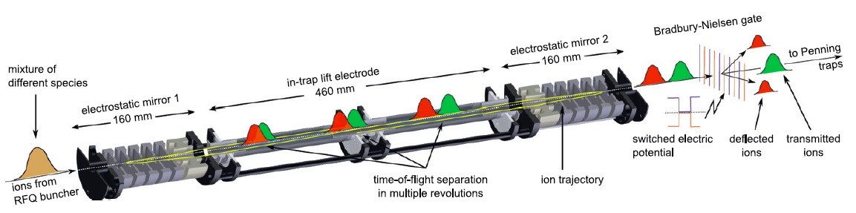
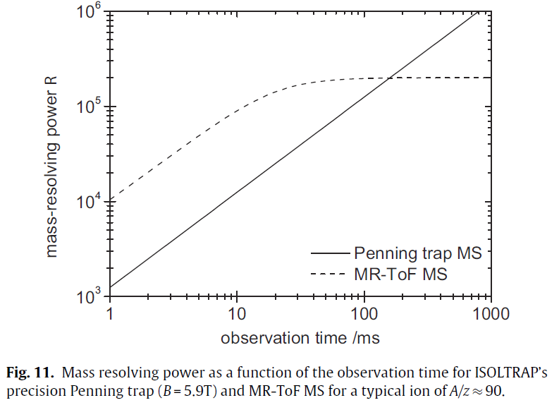
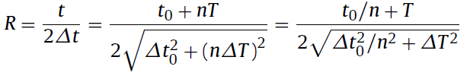
MR-TOF-MS
IJMS 349 (2013) 123
Multi-reflection time-of-flight mass spectrometer based on Greifswald/ISOLDE design
Can be operated in beam cleaning mode (δm/m ∼ 10⁻⁴) or mass-measurement mode (δm/m > 10⁻⁵)
Resolution limited by dispersion of MR TOF

Slide 15
A basic gas stopping cell
1st RF+DC funnel
DC cage
DC grid
High-energy ion beam
Cloud of stopped ¹⁰⁰Sn ions
P_{o} = 300 mbar, T_{o} = 70 K
Entrance window –
titanium 10 µm foil
1st nozzle

Slide 16
Simulated extraction efficiency through the 1st nozzle
Peak-to-peak RF voltage
applied to the funnel electrodes
Extraction times < 4 ms
can be obtained for
all ions stopped in the cell
applied to the DC cage and funnel electrodes

Slide 17
A bunching gas cell
Ion buncher
He gas stopping cell
Extraction RF-only funnels
3∙10⁻⁴ mbar
DC grid
5 mbar
0.8 mbar
E_{DC} > 80 V/cm
RF+DC 1st funnel
300 mbar
Entrance window
DC cage
T = 70 K

Slide 18
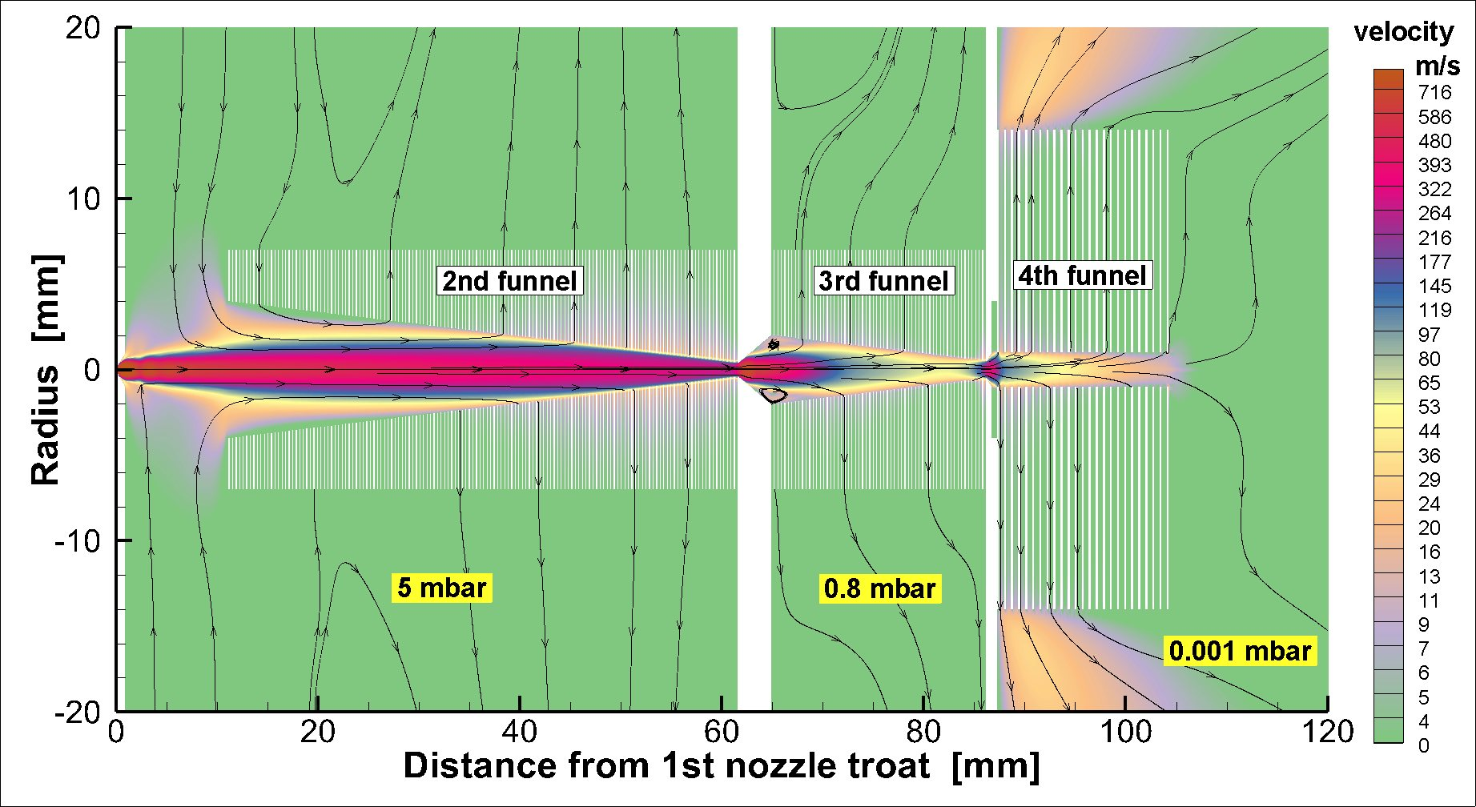
RF-funnel system for ion extraction & bunching
Gas dynamic simulation for velocity flow field
E_{DC} > 80 V/cm
Extraction lens
is placed at 10 mm
downstream
the 4th funnel exit
(not shown)

Slide 19
Bunched operation for ¹⁰⁰Sn
Time-of-flight spectrum of the extracted beam

Slide 20
Bunched operation for ¹⁰⁰Sn
Axial velocity spectrum of the extracted bunch

Slide 21
Bunched operation for ¹⁰⁰Sn
Radial velocity spectrum of the extracted bunch

Slide 22
Summary
EMMATrap allows measurement of very exotic isotopes that are inaccessible through ISAC
Ion extraction development using RF-gas catcher and buncher at McGill in collaboration with V. Varentsov
New device allows for a compact installation and removal at EMMA focal plane
Many techniques EMMATrap well established at radioactive ion facilities
Removal of Penning trap allows for earlier operation
More flexible 5-year plan

Slide 24
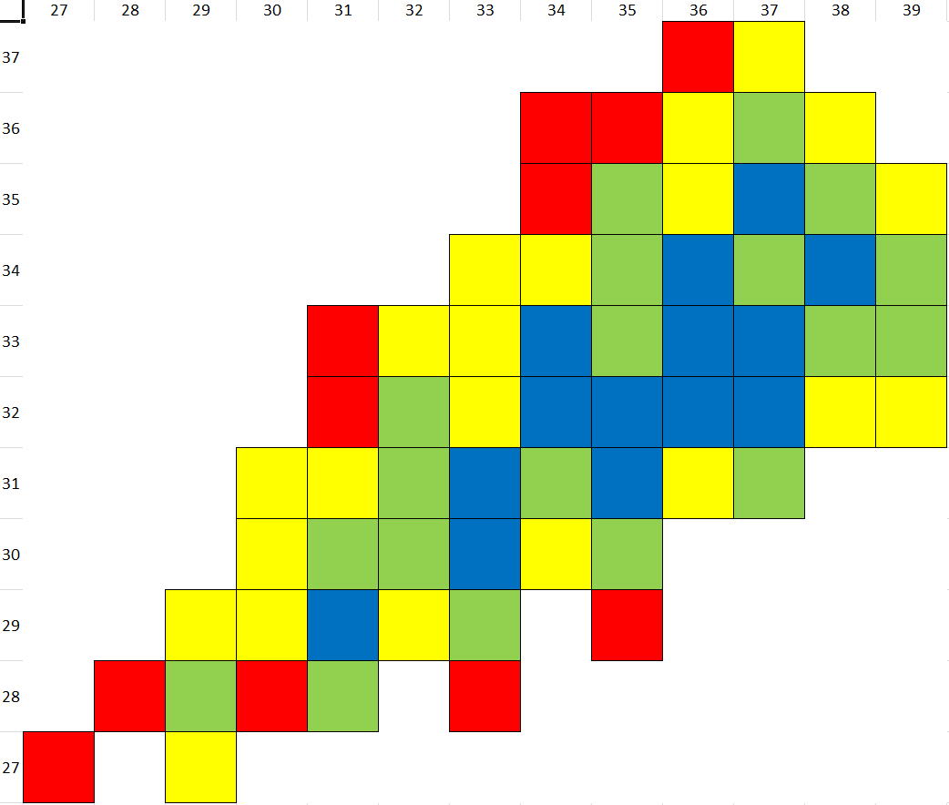
The rp-process case ⁷⁰Kr
Rb
Kr
Br
Se
As
Ge
Ga
Zn
Cu
Ni
Co
³⁸K + ⁴⁰Ca
200 MeV
$$σ\text{ (}\text{mb}\text{)}$$
$$25<σ$$
⁷⁰Kr
$$5<σ<25$$
$$0.1<σ<5$$
$$σ<0.1$$
→ Impossible to produce at ISAC
ISAC yields
⁷²Kr: 440/s (measured)
⁷⁰Kr: ~0.2/s extrapolated assuming yield reduction of 50/n
Z
Possible production and separation at EMMA
N

Slide 25
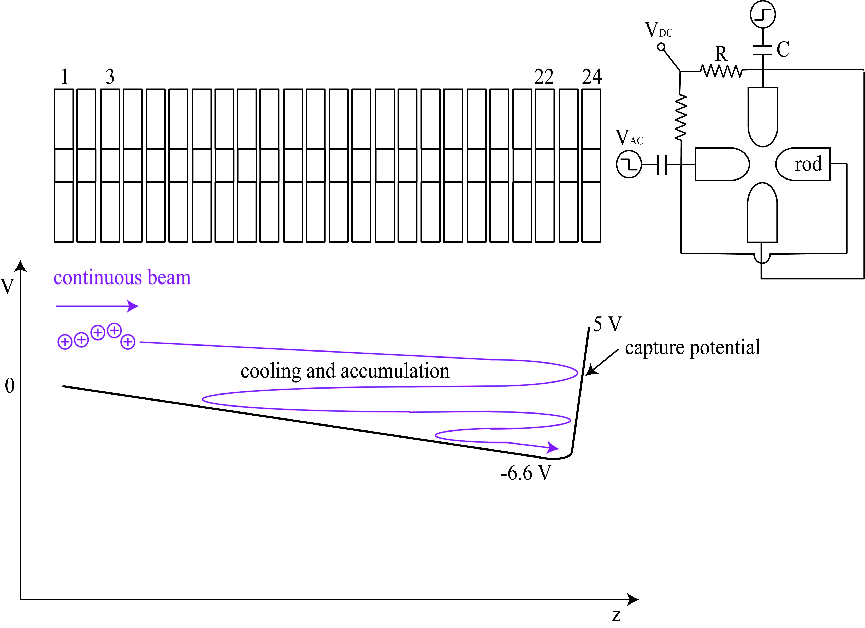
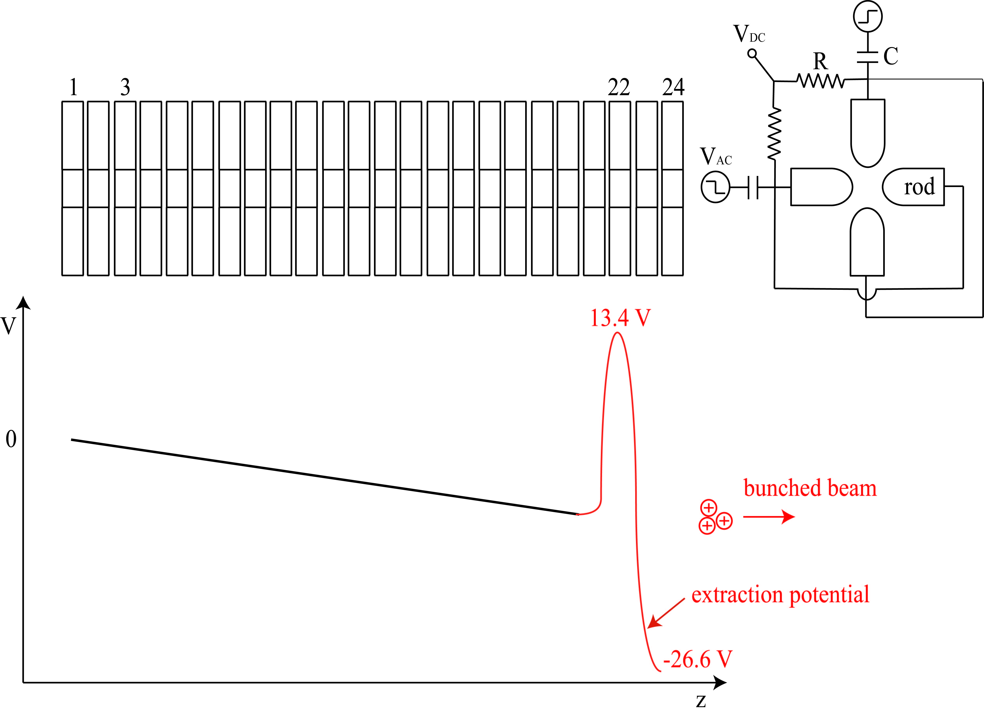
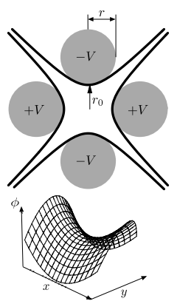
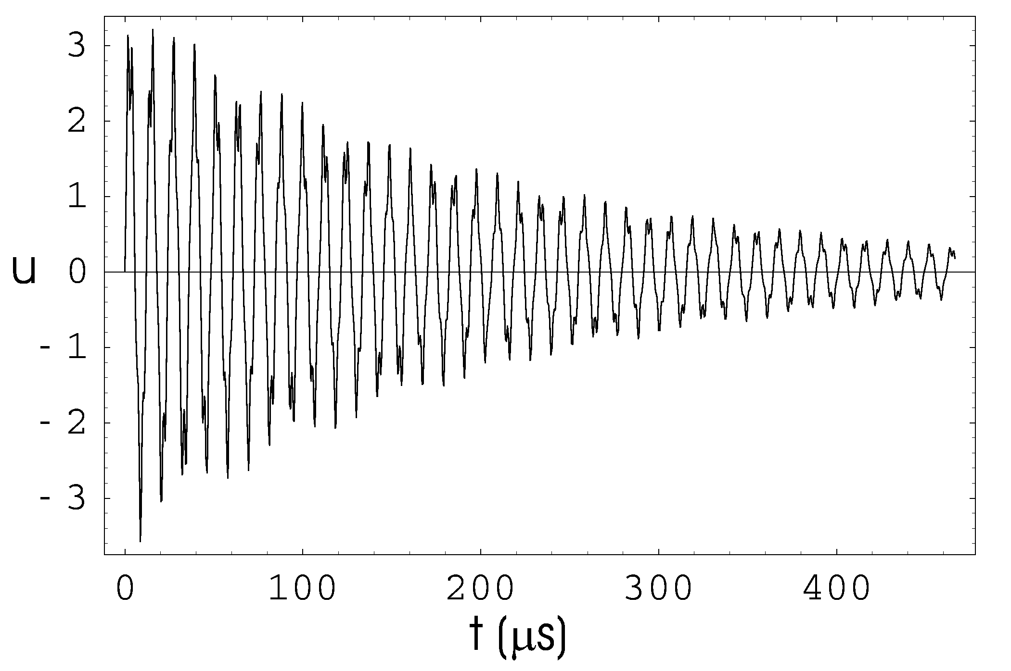
Linear Paul Trap
The TITAN RFQ
Slide courtesy of T. Brunner
10 mm
Necessary ingredients
250 kHz to 1 MHz RF along the electrodes
Axial DC gradient
Buffer gas cooling on the order of a few ms
(mm)
Similar to TITAN RFQ
NIMA 676 (2012) 32
Radial trajectory of ¹³³Cs in 2.5 x 10⁻² mbar
Viscous drag model calculation

Slide 26
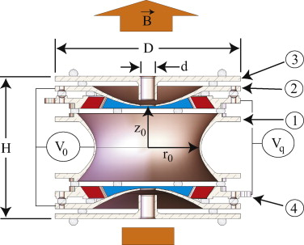
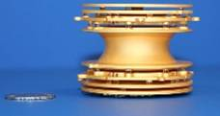
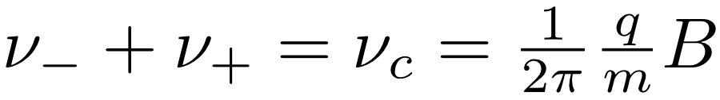
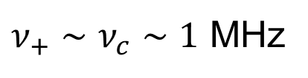
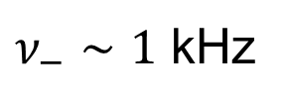
Penning trap
Cyclotron frequency:
Superposition of
strong magnetic field
weak electrostatic quadrupole field
Motion of ions well understood:
Three Eigenmotions can be coupled using RF
Allows us to manipulate motion:
transfer from one motion into the other
$ν_{−}∼1$ kHz
δm/m > 10⁻⁷
Half lives below 10ms measured at TITAN
$ν_{+}∼ν_{c}∼1$ MHz
Notes:
Talk about decoupling of eigenmotions
$ν_{−}$ weakly mass dependent
$ν_{+}$ strongly mass dependent

Slide 27
EMMA without trap
Slide courtesy of T. Brunner
Primary
beam
Stopper
gas cell
Laser
ionization
Tagging of reaction products
Stopping of ions in He gas cell
Possibility of laser-ionization (optional)
Cooling and bunching of ions
Separation from contamination in TOF spectrometer
High-precision m/q measurement in Penning trap
Mounted on a platform
Off-line test of setup
Interchangeable with focal plane detector of EMMA
Penning trap will be installed permanently
Quadrupole stopper and buncher
Multi-reflection TOF
m/q separation
Mass measurement
Penning trap
$$ν_{c}=\frac{q}{m} \frac{B}{2π}$$
Notes:
We would need to build either a removable stopper cell or stopper cell/RFQ combo

Slide 28
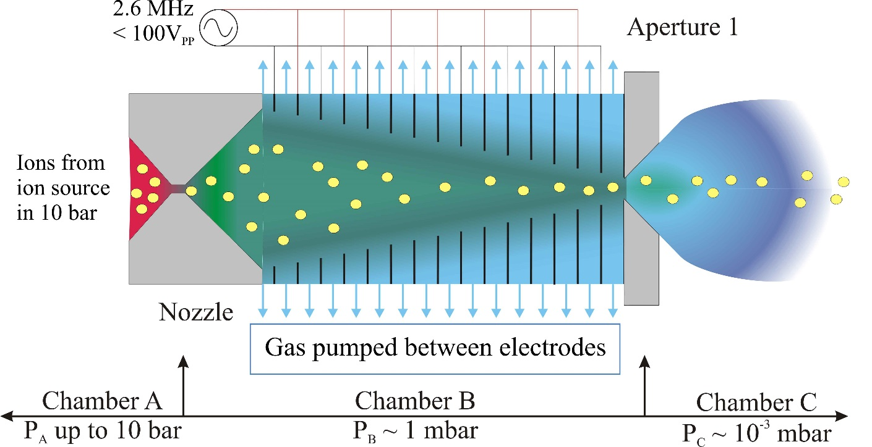
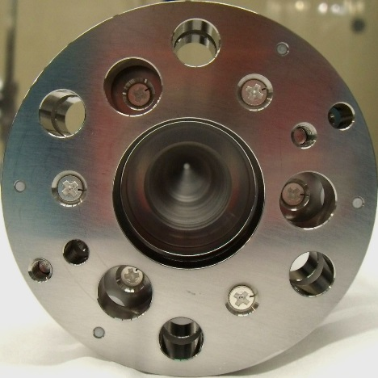
RF funnel concept
Slide courtesy of T. Brunner
RF-funnel concept for Ba-tagging:
Converging-diverging nozzle
2 Stacks total 301 electrodes
RF-field applied to electrodes
P_{A} = 10 bar, P_{B} = 1 mbar
RF carpet
To LPT
Stopper cell
VRF = 120 V, f = 10 MHz
Simulated Ba⁺ transmission ~95%
VRF = 25V, f = 2.6 MHz
Simulated Ba⁺ transmission ~72%
Possible to extract ions from 10 bar Xe → initial design (and Ba-tagging design) by V. Varentsov for ion extraction from 0.1-1bar He
Optimization of design by V. Varetsov at GSI-FAIR
Extraction times O(10ms)
Int. J. Mass Spec. 379, 110 (2015)

Slide 29

Gas stopper cell
Slide courtesy of T. Brunner
Design of cryogenic gas catcher for the Super-FRS @ FAIR
From http://www.euroschoolonexoticbeams.be/site/files/2013_05_ExoBeams13_PThirolf_GasCell.pdf
He gas at 0.1-1bar
0.6mm
4 electrodes/mm
RF-carpet of cryogenic stopper
EPL, 96 (2011) 52001
Ions
RF-funnel
For ion extraction
Exit hole
DC cage
electrodes
RF carpet
Degrader/
Entrance windows
Inner chamber at ~60-70K
Vacuum chamber for
Insulating vacuum
Gas stopper cells used at fragmentation facilities to stop RI-beams (GSI/FAIR, FRIB, RIKEN, KUL Leuven, CARIBU @ ANL, …)
Extraction efficiencies of >10% have been observed
Extraction times on the order of 10ms
Up to 10³ ions/s space charge effects negligible; at higher ion intensities reduced transmission efficiency due to space-charge effects
Extreme pure gas required to reduce charge exchange and neutralization in the gas

